Slide 1


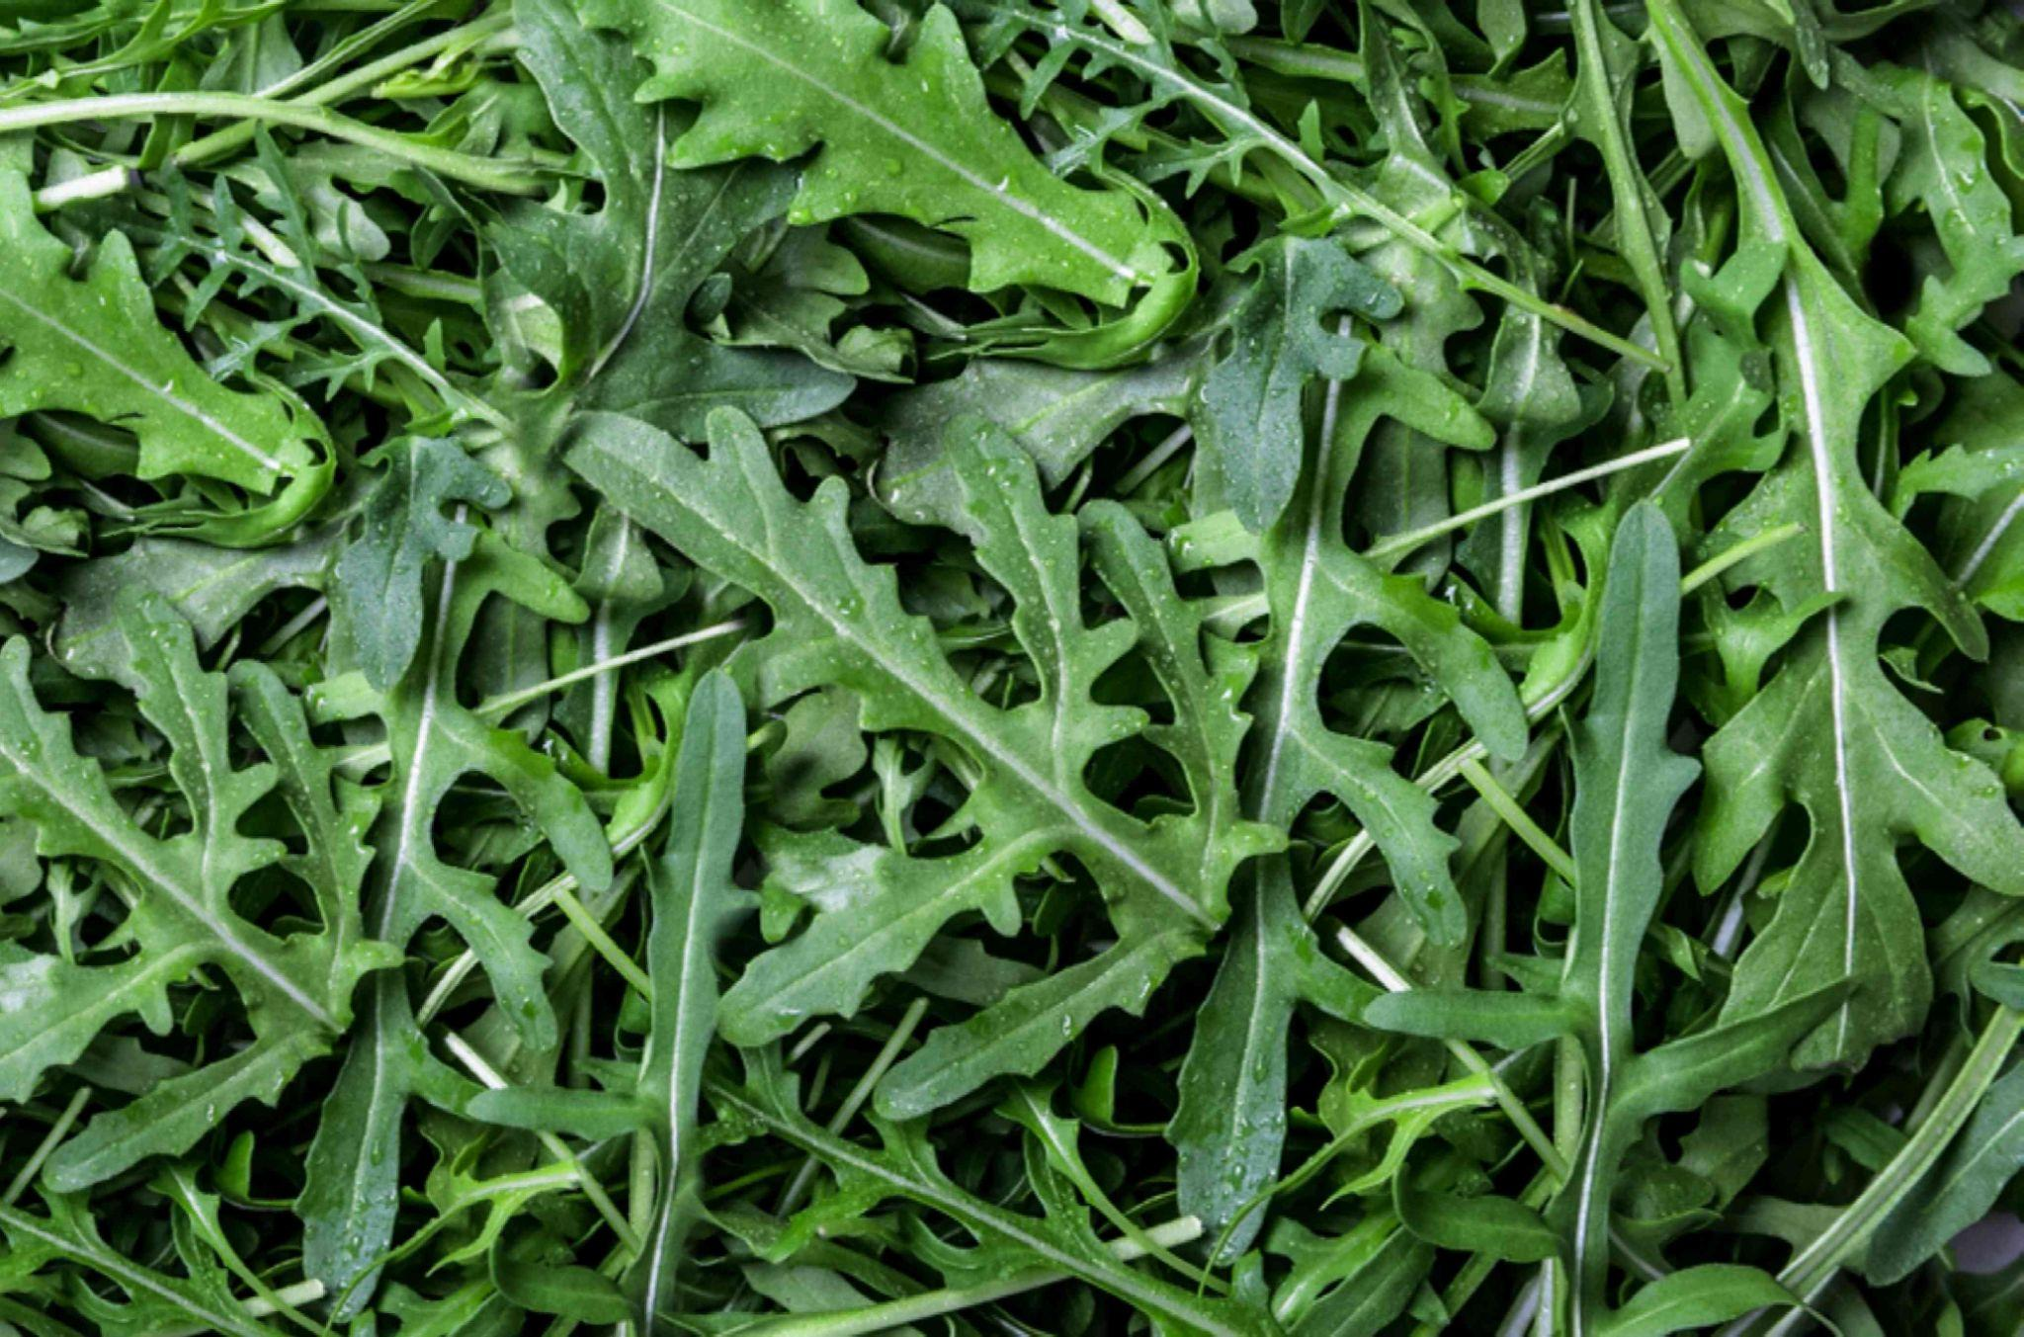
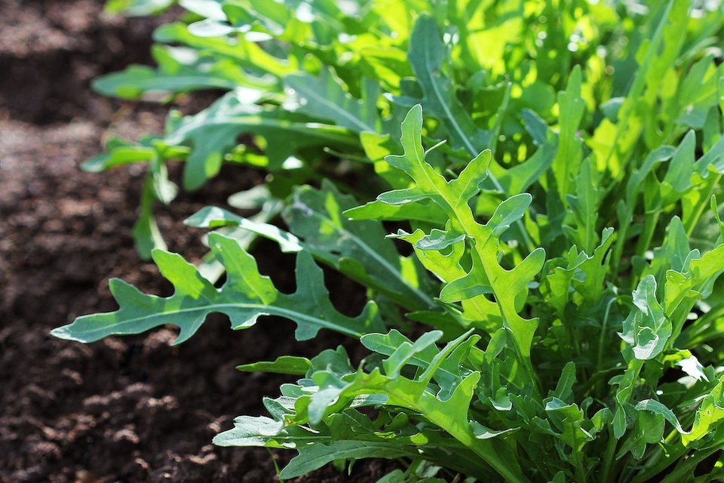
Arugula
A Virtual Field Trip
This Photo by Unknown Author is licensed under CC BY

Slide 2
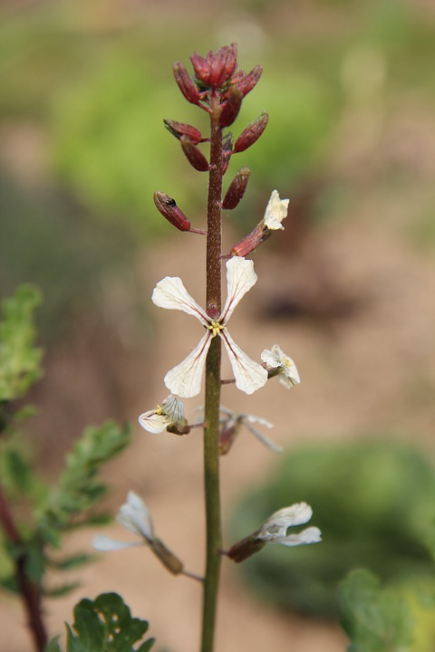
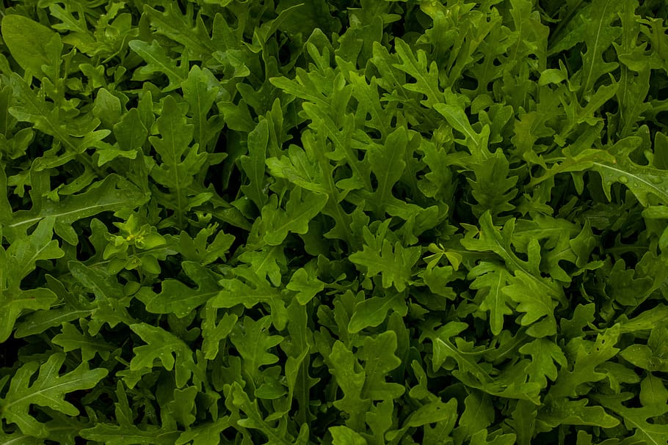
Part of the Mustard Family
Brassicaceae is known as the Mustard Family
Eruca is the genus
Eruca sativa is the botanical name
The mustard family are flowering plants & include cruciferous vegetables
The flowers are in a shape of a cruciform (cross)
Cruciferous vegetables include broccoli, brussels sprouts, cabbage, cauliflower, collard greens, kale, & radish
Notes:
https://www.britannica.com/plant/Brassicaceae
Arugula is part of the Brassicaceae family, formally known as the Cruciferae Family aka the mustard family of flowering plants.
Broccoli, brussel sprouts, kale, cauliflower, radish, cabbage, collard greens are cruciferous vegetables.
cruciform (e.g., in the form of a cross) with four petals and four sepals; the plants are commonly referred to as “crucifers” or “cruciferous” for that reason.
Family: collection of plants that share characteristics;
Genus: is the generic name, but not the species name.
Botanical: the scientific name given to a particular plant species.
Botany: the scientific study of plants, including their physiology, structure, genetics, ecology, distribution, classification, and economic importance.

Slide 3
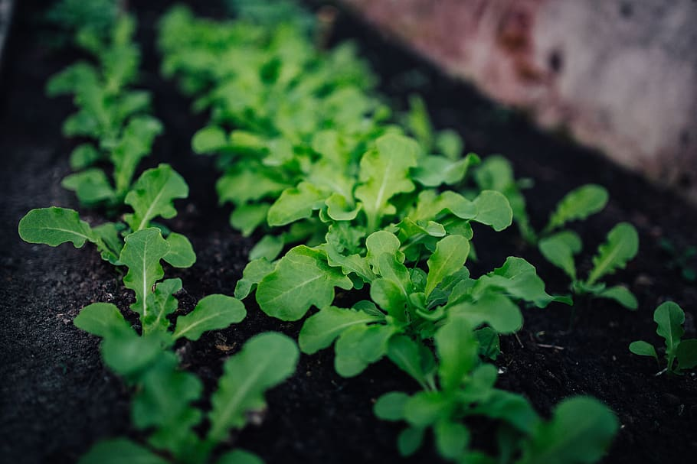
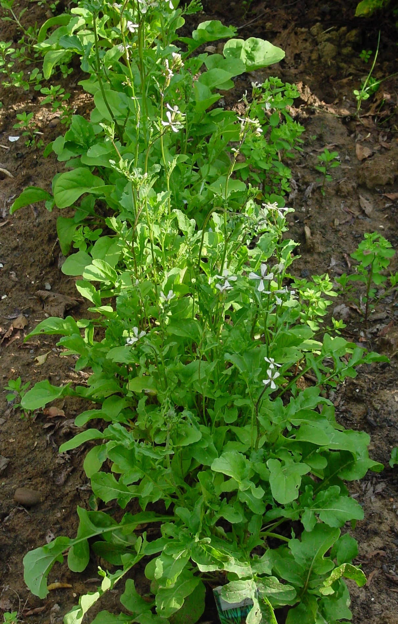

How Does Arugula Grow?
Arugula is a leafy green herb that grows in the soil
It’s also known as roquette, salad rocket, garden rocket, or rugula
  “garden rocket” since it grows extremely fast (rocket speed)
  Leaves are ready to pick 40 days after planting
  Its green stem can reach 8-40 inches in height
Arugula loves cold weather and grows best in climate between 45-65 degrees F
It prefers full sun & needs at least six hours of direct sunlight
Arugula is in season all year round!
Notes:
https://www.britannica.com/plant/arugula
https://www.softschools.com/facts/vegetables/arugula_facts/2771/
https://www.thespruce.com/growing-arugula-in-garden-pots-848160
Arugula grows best in full sun, meaning at least six hours of direct sunlight on most days. But as the temperature starts to rise, provide some afternoon shade. This will help to prevent the plants from wilting and bolting (flowering and going to seed), extending your harvest for as long as possible. It can't survive a frost and doesn't like the high heat of summer.
aka roquette, salad rocket, garden rocket, or rugula, "garden rocket" refers to the fact that arugula grows extremely fast (rocket speed). Leaves are ready for the harvest 40 days after sowing of seed.

Slide 4
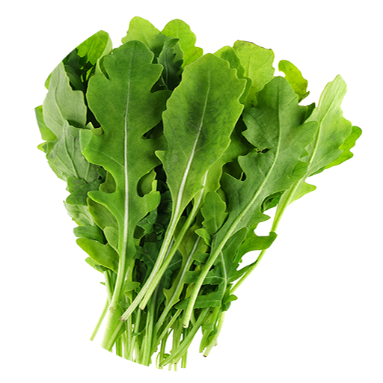


Where Did it Come From?
Arugula came from the Mediterranean & has been growing wild since the ancient times
It was used in the ancient Egyptian and Roman empires
Very popular in Italy, Portugal, Morocco, & Turkey
It’s a regular ingredient in Italian cuisine
It was brought to America from the colonists (European immigrants)
It’s a common salad vegetable
Notes:
https://i0.wp.com/greensxm.com/wp-content/uploads/2018/03/arugula-title.jpg
https://thrivecuisine.com/garden/where-does-arugula-come-from/
Arugula has historically been a staple ingredient in Italian cuisine as the subtly bitter, spicy cultivar was one of the most popular salad greens used in Ancient Rome. https://specialtyproduce.com/produce/Arugula_301.php
https://foodprint.org/real-food/arugula/
Arugula is believed to be native temperate regions of the Mediterranean in Southern Europe and has been growing wild since ancient times. The plant's first written record dates back to the 1st century CE, and the spicy greens were widely used in Ancient Egyptian and Roman empires. Arugula was eventually introduced to the New World through European immigrants, and over time, the greens have experienced periods of immense popularity to seasons of disdain, with the most recent surge in the 1990s among American chefs and consumers. Today Arugula is common worldwide, cultivated through commercial growers and sown in home gardens as a pest-resistant plant. The nutty greens are also sold through farmer’s markets, specialty grocers, and supermarkets.
in Mediterranean cuisines for thousands of years.

Slide 5
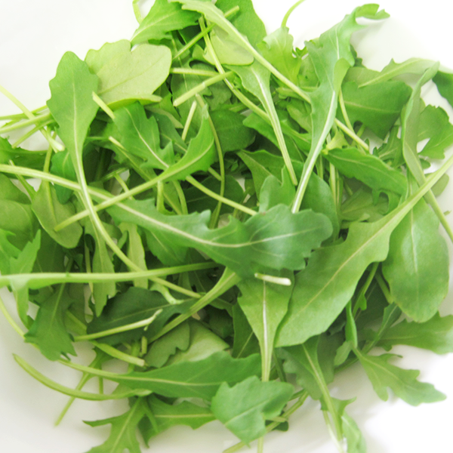
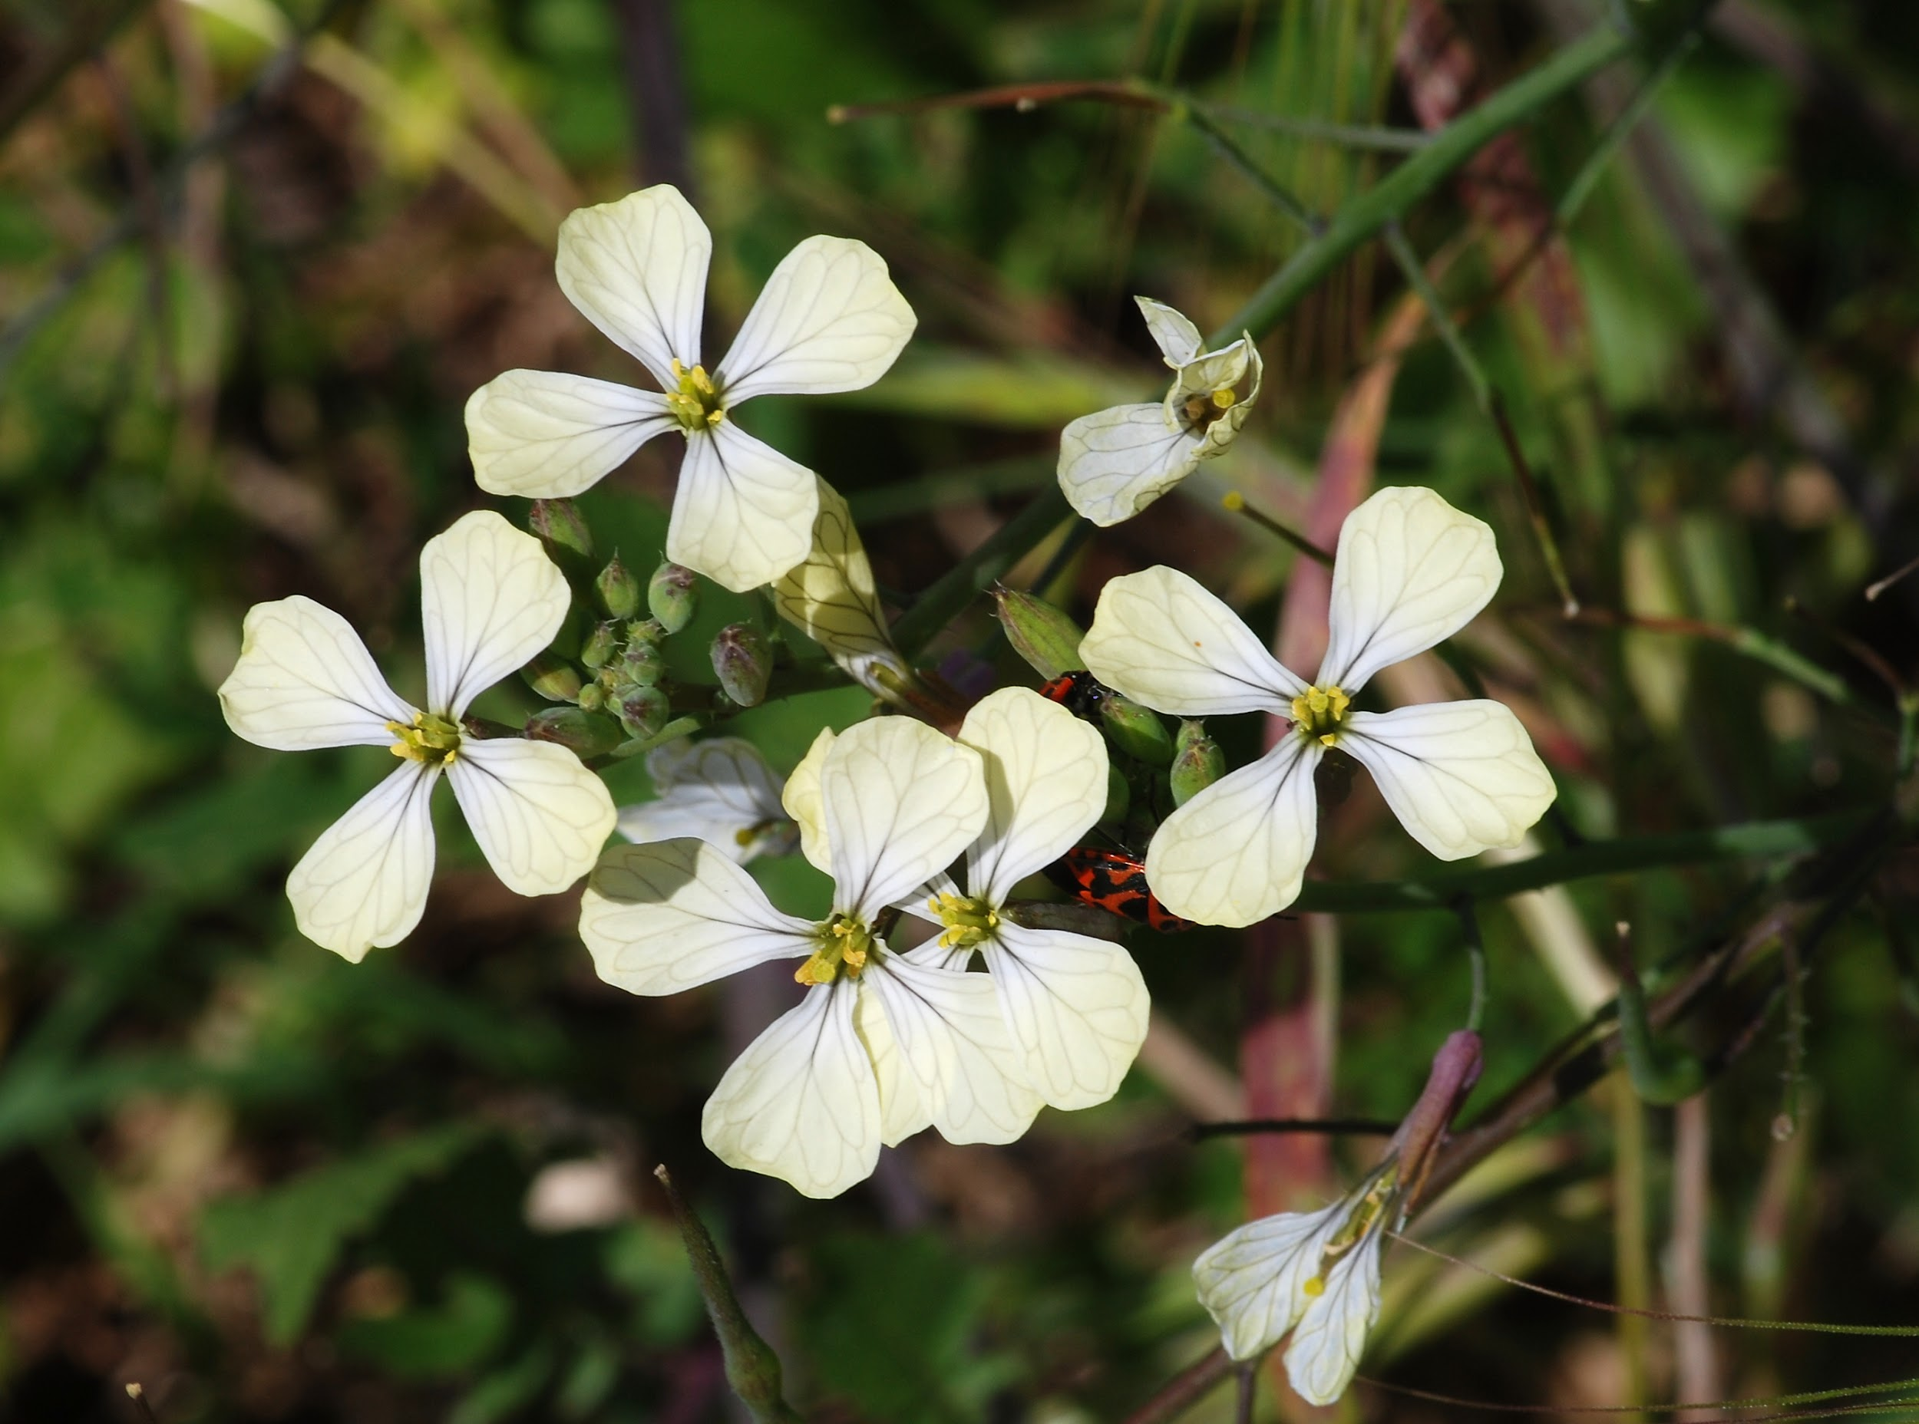
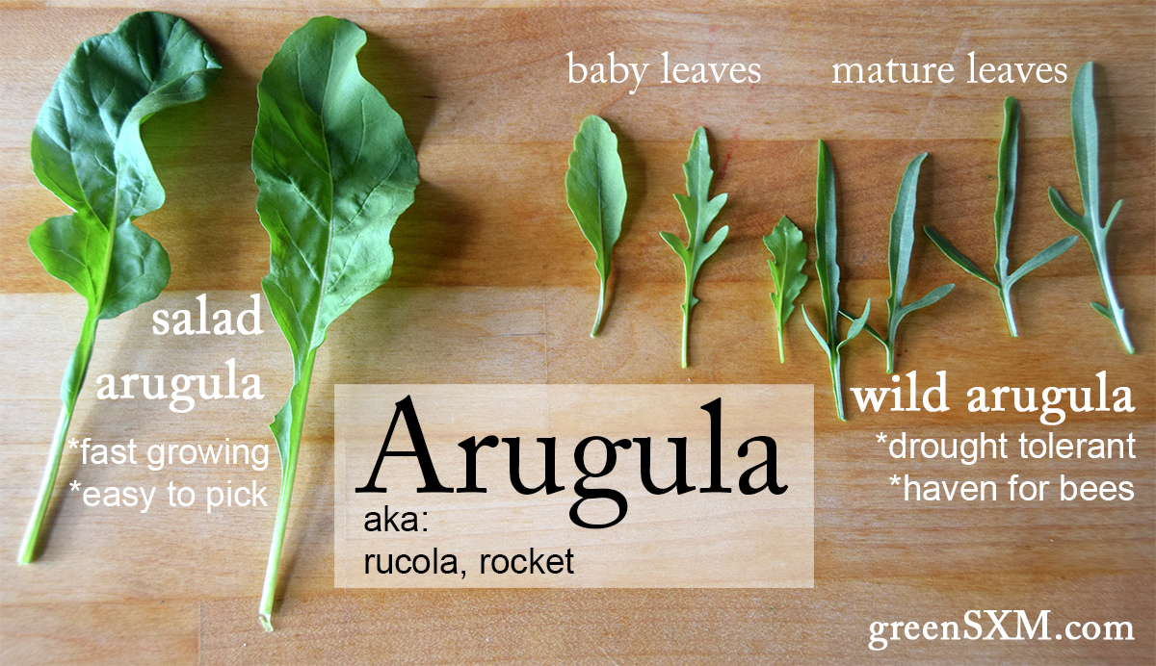
Types & Fun Facts
The leaves, stems, flowers, and seeds are all edible!
The seeds can be used to make oil
Baby arugula has a lighter flavor & tender texture
Notes:
The leaves are perishable and go bad quickly. If you are not going to eat them within a week, you can consider freezing the leaves for later use in cooking. Arugula is described as having a nutty and peppery flavor. It is used in salads. The leaves, stems, flowers, and seeds are all edible. It is a good source of vitamins A and C, which are important for eye health.
https://i0.wp.com/greensxm.com/wp-content/uploads/2018/03/arugula-title.jpg (picture credit)
the immature greens carry a milder, sweeter flavor with a tender texture.

Slide 6

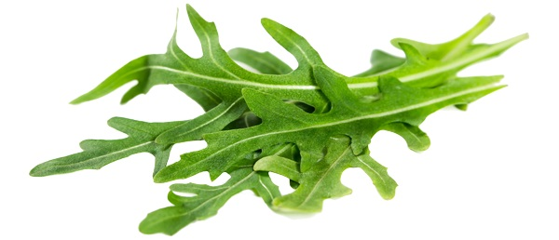
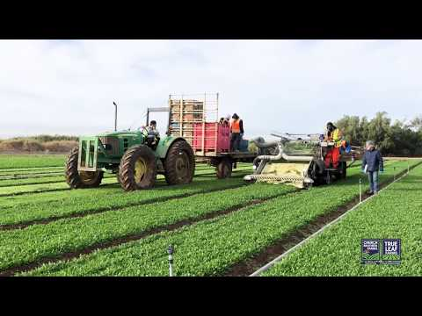
From Field to Store
Watch this 2 min video to see how arugula is harvested on a California farm
Notes:
https://www.youtube.com/watch?v=UiluzAuF42Q

Slide 7


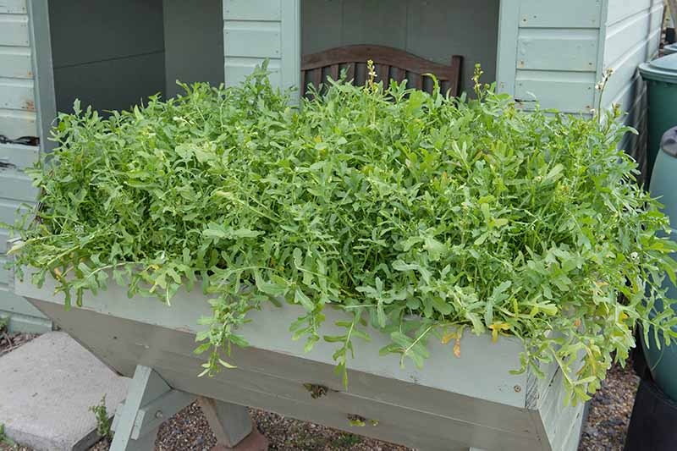
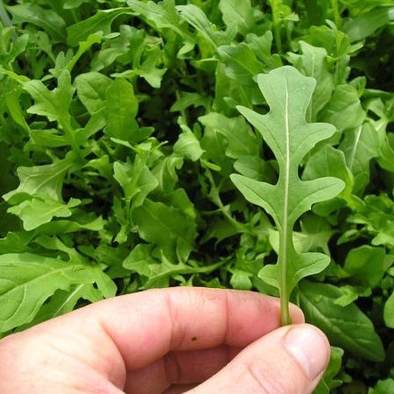
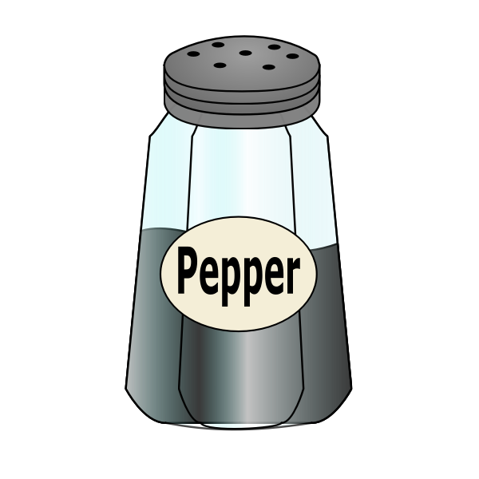
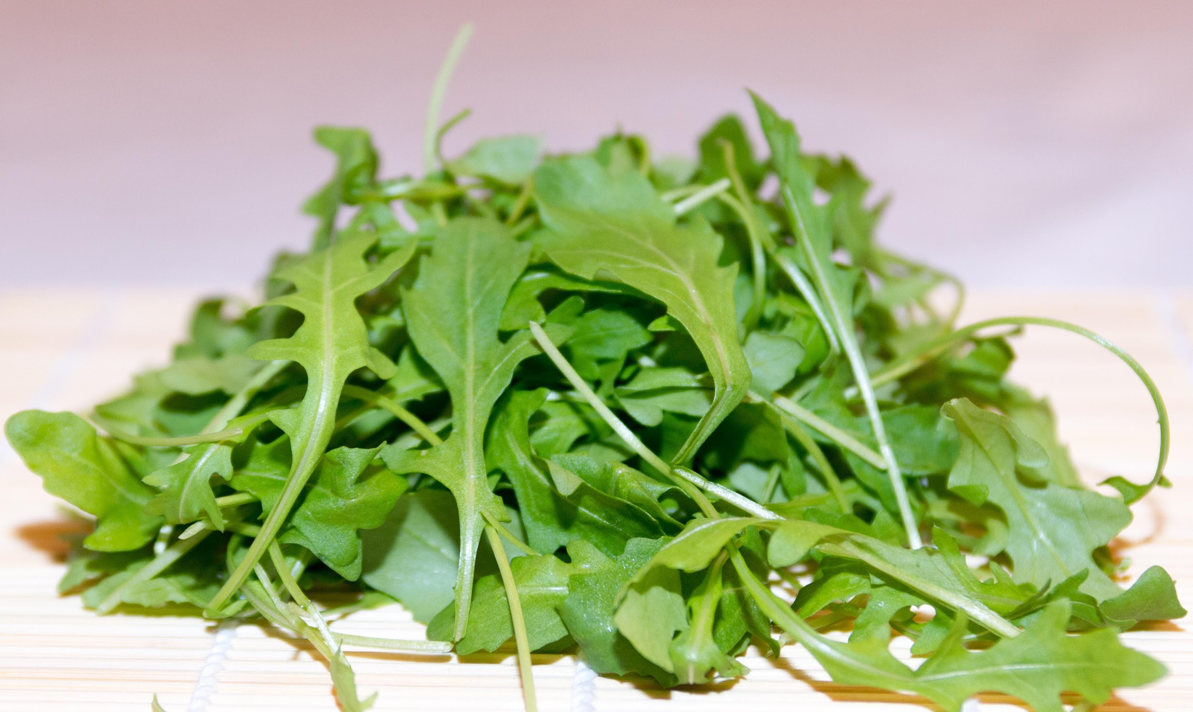
How to Pick Them
Look for bright green crisp leaves, not yellow or limp ones
Feel for dry tender leaves, not mushy
Smell for spicy, nutty freshness
Taste is peppery & mustardy
Notes:
https://dpi.wi.gov/sites/default/files/imce/school-nutrition/pdf/fact-sheet-arugula.pdf
Arugula is described as having a nutty and peppery flavor. It is used in salads. The leaves, stems, flowers, and seeds are all edible. It is a good source of Vitamin A & C.
As for any salad green, you want bright green, crisp leaves as opposed to yellow or wilted ones.
Be on the lookout for firm leaves without any yellow or signs of mushiness. Mass-produced “baby” arugula in pre-washed sacks tends to be very mild. “Wild arugula” is another variety with lacier leaves and a more assertive flavor.

Slide 8
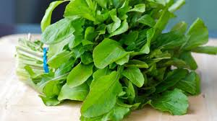
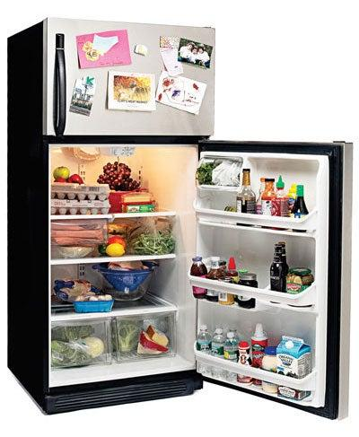
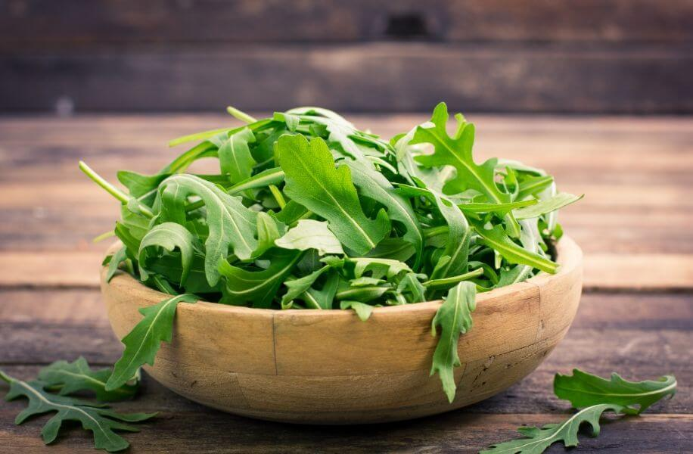
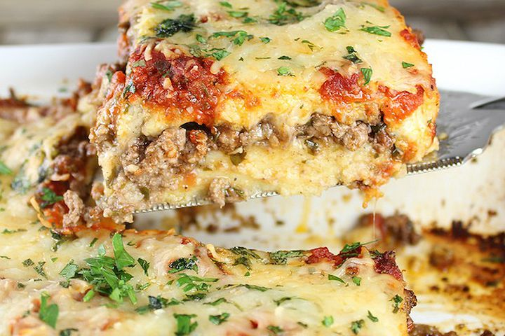

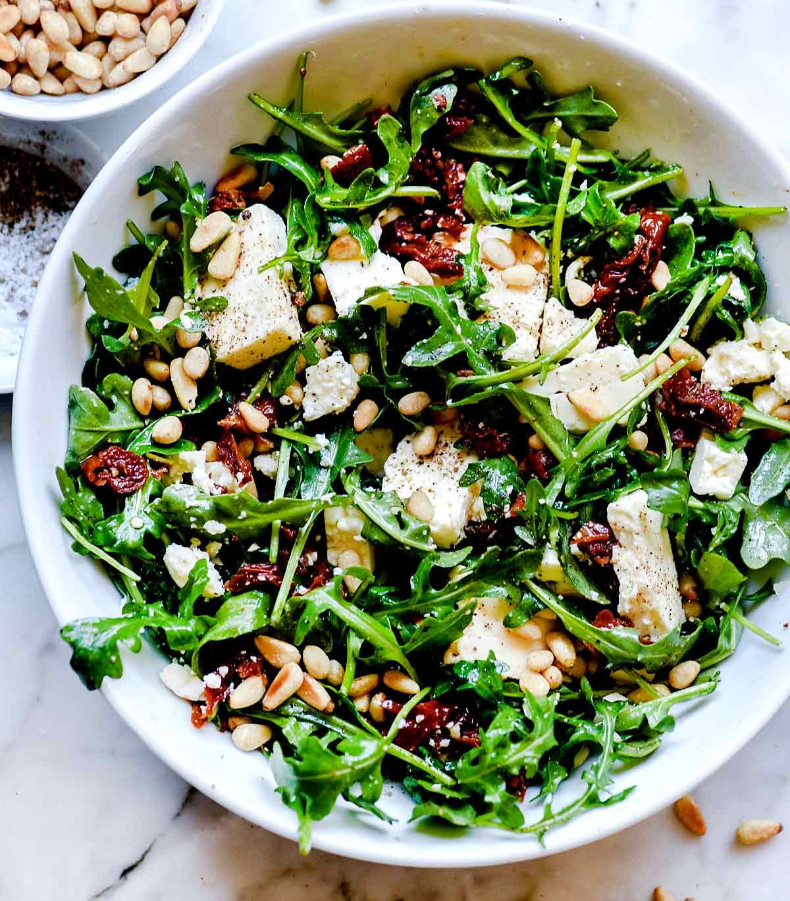
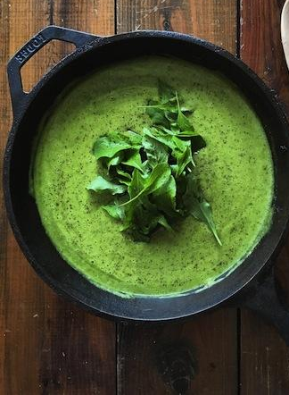

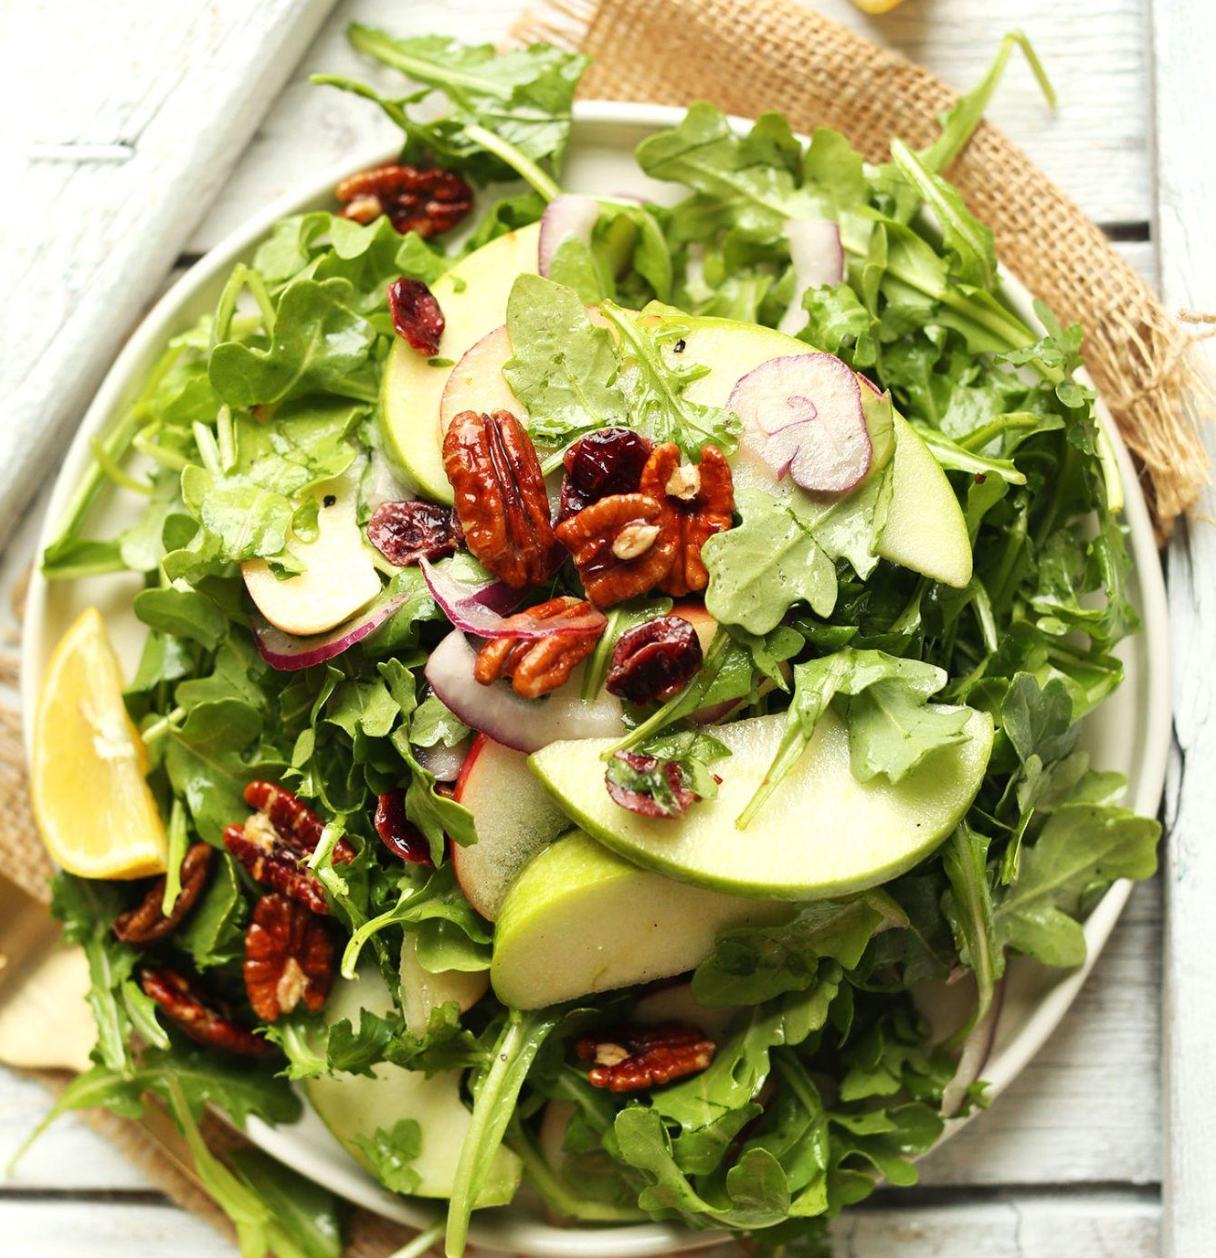
How to Store, Wash, & Eat Arugula
Arugula leaves can go bad quickly
Refrigerate it for up to 3-5 days
Wash when ready to use
Consider freezing arugula leaves if not eaten right away
Can be eaten raw or cooked. Eat them as a salad, on top of pizza, in sandwiches, soups, lasagna, pasta dishes, & more!
Notes:
https://www.stilltasty.com/fooditems/index/16418
https://themom100.com/2019/08/how-to-cook-with-arugula/

Slide 9
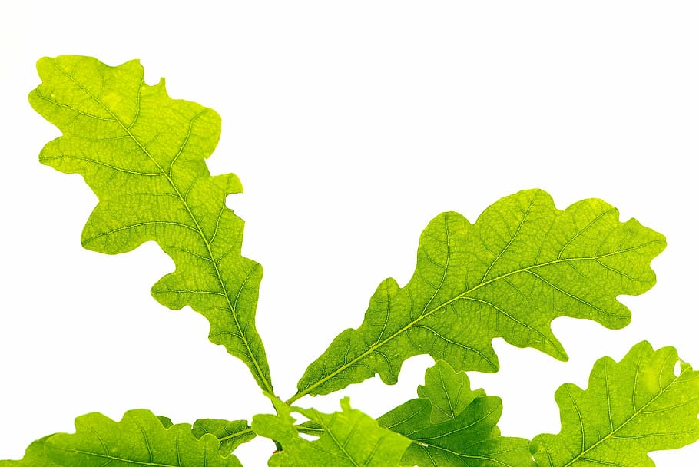

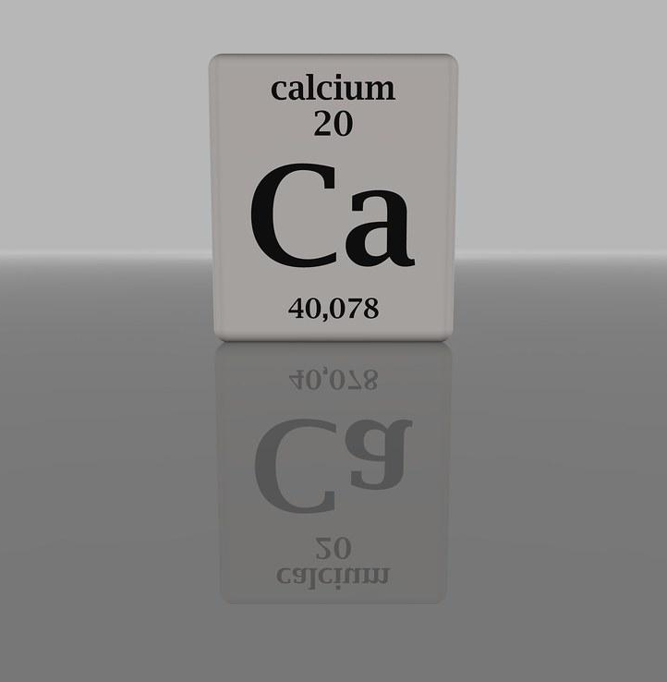


Nutritional Facts
Arugula is high in:
Calcium, folate, vitamin C, A, & K
Great for bone & heart health
Important for healthy cell growth & function
Strengthens the immune system
Notes:
https://appreciategoods.com/arugula-health-benefits/

Slide 10
References
Appreciate
https://appreciategoods.com/arugula-health-benefits/
Britannica
https://www.britannica.com/plant/arugula
https://www.britannica.com/plant/Brassicaceae
Food Print
https://foodprint.org/real-food/arugula/
Soft Schools
https://www.softschools.com/facts/vegetables/arugula_facts/2771/
Specialty Produce
https://specialtyproduce.com/produce/Arugula_301.php
Still Tasty
https://www.stilltasty.com/fooditems/index/16418
Notes:
https://www.britannica.com/plant/Brassicaceae
https://www.britannica.com/plant/arugula
https://www.softschools.com/facts/vegetables/arugula_facts/2771/
https://www.thespruce.com/growing-arugula-in-garden-pots-848160
https://thrivecuisine.com/garden/where-does-arugula-come-from/
https://specialtyproduce.com/produce/Arugula_301.php
https://foodprint.org/real-food/arugula/
https://www.youtube.com/watch?v=UiluzAuF42Q
https://www.stilltasty.com/fooditems/index/16418
https://themom100.com/2019/08/how-to-cook-with-arugula/
https://appreciategoods.com/arugula-health-benefits/

Slide 11
References
The Mom 100
https://themom100.com/2019/08/how-to-cook-with-arugula/
The Spruce
https://www.thespruce.com/growing-arugula-in-garden-pots-848160
Thrive Cuisine
https://thrivecuisine.com/garden/where-does-arugula-come-from/
Church Brothers Farms
https://www.youtube.com/watch?v=UiluzAuF42Q

